Slide 1
Python file handling

Slide 2

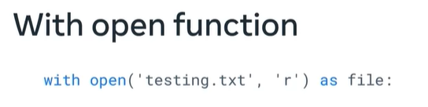
Open and close-open
Need to close
File.close()
No Need to close

Slide 3
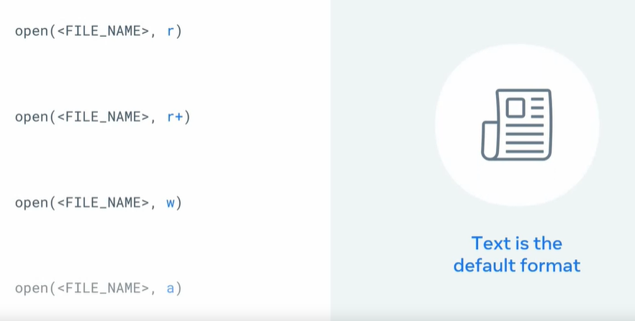
Open file in text mode
Read only
Opens the file for both reading and writing.
If the file does not exist, it raises a FileNotFoundError.
If the file exists, it does not truncate (erase) the contents of the file.
It allows you to read from and write to the file, making it suitable for situations where you need to both read existing data and modify it or add new data.
Read and write
write
If the file exists, it truncates (erases) its contents.
If the file does not exist, it creates a new file.
you cannot read from the file.
append

Slide 4
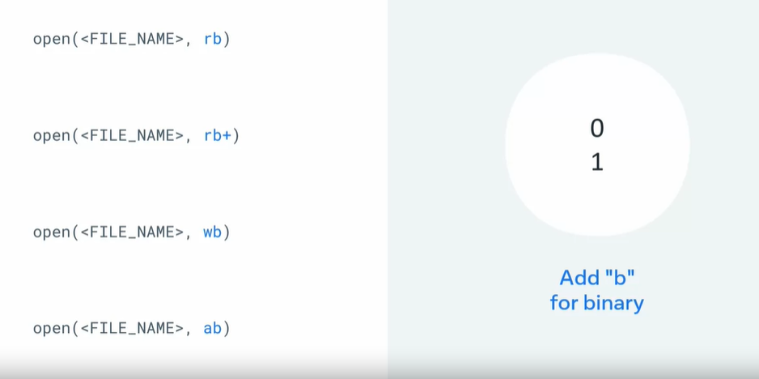
Open file in binary mode

Slide 5
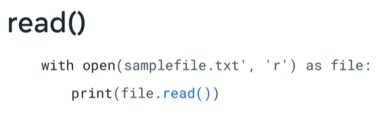
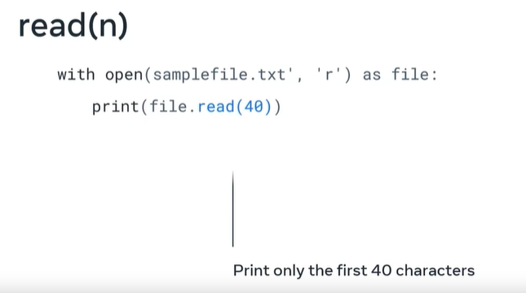
read()

Slide 6
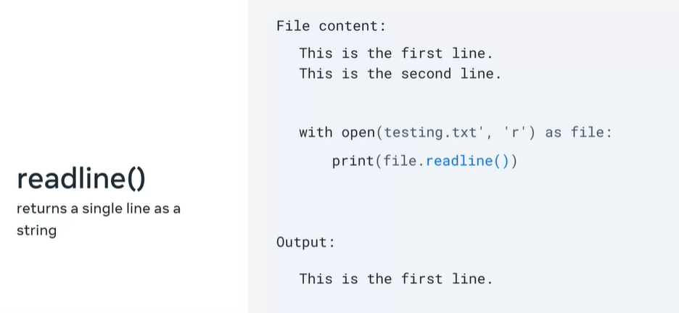
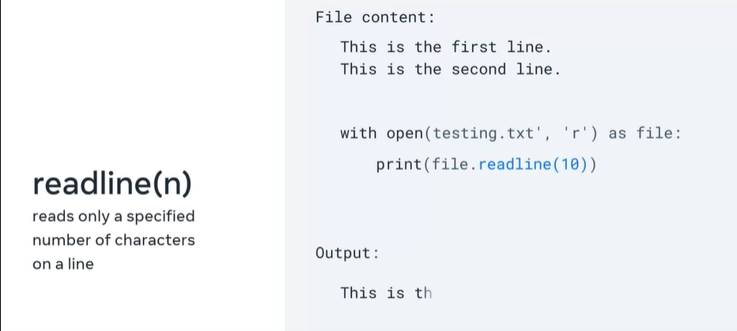
readline()

Slide 7
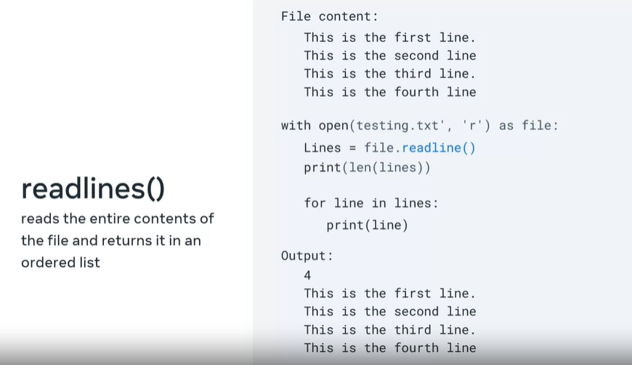
readlines()

